Slide 1
Tax Increment Refinancing Zone (TIRZ) Presentation
Prepared By Economic Development
February 24, 2014

Slide 2
What is a TIRZ?
Tax Increment Reinvestment Zones (TIRZs) are special zones created by City Council to attract new investment to an area. TIRZs help finance the cost of redevelopment and encourage development in an area that would otherwise not attract sufficient market development in a timely manner. Taxes attributable to new improvements (tax increments) are set-aside in a fund to finance public improvements within the boundaries of the zone.

Slide 3

Tax Increment Financing
Tax Increment Reinvestments Zones (TIRZ) were created by the Texas Legislature to help finance the cost of improvements needed to promote development or redevelopment in specific geographic areas (TIRZ Zone) of a community.
A TIRZ is regulated and monitored by the City in accordance with Chapter 311 of the Texas Tax Code
You can read more about what the Texas Comptroller’s Office has to say about Tax Increment Financing on their website.

Slide 4
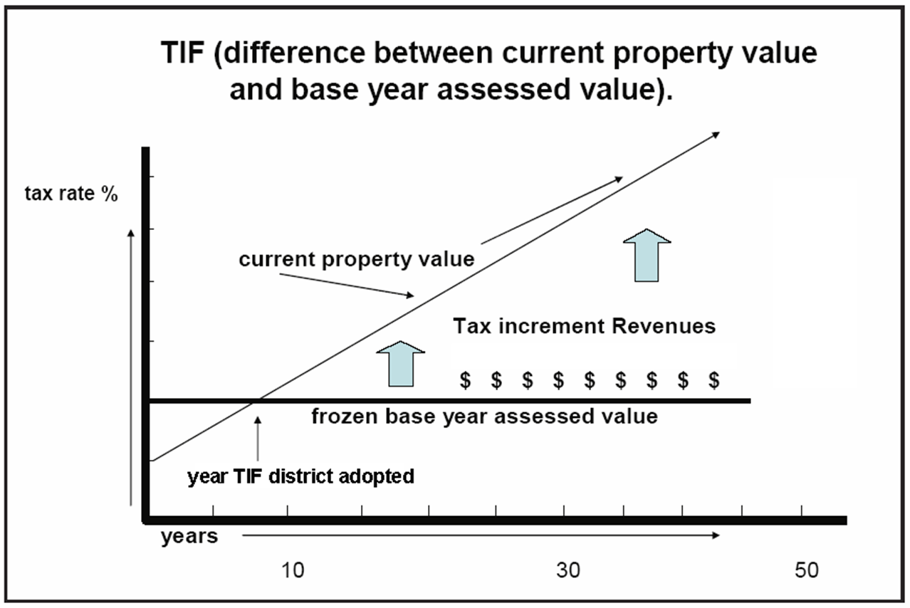
How TIRZ Funding works:

Slide 5
Public improvements allowable under Texas Law:
Public improvements scheduled for the Zones include, but are not limited to, the construction of:
(i) sidewalks, cross walks and pedestrian crossing systems
(ii) storm sewers and drainage ponds,
(iii) sanitary sewers,
(iv) landscaping, streetscape, fountains, works of art, and benches,
(v) plazas, squares, pedestrian malls, trails, and other public spaces,
(vi) parking lots and roadways,
(vii) utility line relocation and installation,
(viii) water system improvements
(ix) parks, and outdoor performance spaces,
(x) bicycle routes and facilities,
(xi) public transportation projects,
(xii) signage, and
(xiii) other related necessary or convenient public improvements (collectively, the “Project Costs”).

Slide 6
What are the criteria for a TIRZ?
Chapter 311 of Tax Code Requires:
311.005 (1) Substantially arrest or impair the sound growth of the municipality… due
to the presence of:
(A) Substantial number of substandard, slum, deteriorated, or deteriorating structures;
(B) Predominance of defective or inadequate sidewalk or street layout;
(C) Faulty lot layout in relation to size, adequacy, accessibility or usefulness;
(D) Unsanitary or unsafe conditions;
(E) Deterioration of site or other improvements;
(F) Tax or special assessment delinquency exceeding fair value of the land
(G) Defective or unusual conditions of title; or
(H) Conditions that endanger life or property by fire or other cause.
311.005 (2) Be predominantly open and, because of obsolete platting, deterioration
of structures or site improvements, or other factors, substantially impair or arrest the
sound growth of the municipality

Slide 7
TIRZ is not…
Not a gift or windfall to developers
Not a tax abatement or rebate of taxes; anyone owning property in the TIRZ pays property taxes, including the developers
Not a “freezing” of taxes or tax rates
Not a mechanism for skirting city regulatory process or codes
Cannot trigger a tax increase

Slide 8
TIRZ has been successful
TIRZ are “tools” and as such are neither inherently good nor inherently bad
Successful TIRZ usually have clearly identified needs and focused solutions, i.e. programs and development partners to fill need (Arlington Stadium was a TIRZ project.)
TIRZ are focused capital improvement programs, paying for needed infrastructure based on likelihood of redevelopment
TIRZ are usually performance based public/private partnerships
TIRZ are usually long term in nature
A few examples of cities who have successfully used TIRZ:
Abilene
Austin
Brownsville
Beaumont
Bryan
Dallas
Ft. Worth
Galveston
Grapevine
Houston
Katy
League City
Pearland
San Antonio
South Lake
Sugar Land
Tyler

Slide 9
Why is TIRZ right for Texarkana, Texas ?
TIRZ is performance-driven, another words, no money is spent until work is completed
Pro-active plan that puts developers on notice of what City may do
Financing structure that is well-understood by the private developers
Ability to influence developer plans and projects over a long term

Slide 10
Texarkana’s TIRZ Time Line
November 2009:
Council approves Ordinance #177-09 creating TIRZ #1 & #2
October & November 2009:
City Council issued Notice of Intent to create TIRZ Districts; 60-day written notice issued to all other taxing units; 7 day Published Notice for Public Hearing on TIRZ Districts; Notice of Public Presentation on TIRZ Districts; City holds joint meeting w/Other Taxing Entities and public presentation over TIRZ Districts; City Council public hearing on TIRZ and vote.
Annual reports filed with Texas Comptroller’s Office for 2010, 2011, 2012

Slide 11
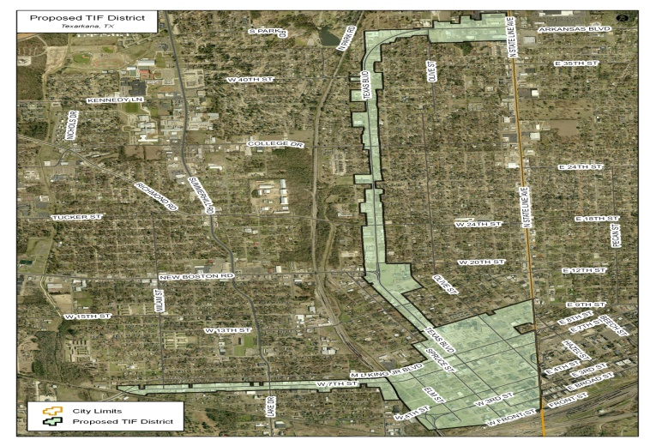
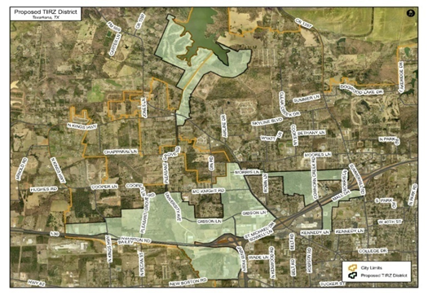
To utilize tax increment financing (“TIF”) in Texas, a tax increment reinvestment zone (“TIRZ”) must be created over the specific geographic area (TIRZ Zone) where the public improvements will be constructed. Zones must be contiguous and are limited to the percentage of residential property allowed in the Zone. Above, Texarkana, Texas’ two zones are pictured.

Slide 12
What is the TIRZ process?
First, the project is presented by developer, property owner, or Public Works to staff for consideration.
Then, city staff makes determination of public benefit and analysis of return on City’s investment
Next, TIRZ board votes on recommendation for inclusion of project to Project List
If the TIRZ board recommends inclusion, Council acts on inclusion of project to Project List
If Council approves project, Council acts on funding from TIRZ based on staff recommendation and funding availability
If approved, staff monitors projects until completed

Slide 13
There are two councils who are charged to protect the city’s interest:
The TIRZ Board makes recommendations to the city council concerning the administration of the TIRZ Zones, prepares and adopts project plans, prepares reinvestment zone financing plans, and; prepares, implements, monitors, and submits all plans and an annual report to the city council for approval.
Meanwhile, the Texarkana, Texas City Council approves the final Project and Financing Plan, which contains the vision, appoints TIRZ Board of Directors, approves funding source for projects, approves Development Financing Agreements, and approves the Issuance of Debt if appropriate.

Slide 14
Summary
Pros:
Performance based
Will not burden existing residents
Requires a plan that informs public and private sector of vision, goals and eligibility
Cons:
Long term economic development tool
Perception of developer reimbursements as “giveaways” will require transparency and full disclosure
Board must remain fully engaged

